Slide 1

Process of Creating Simulation

Slide 2
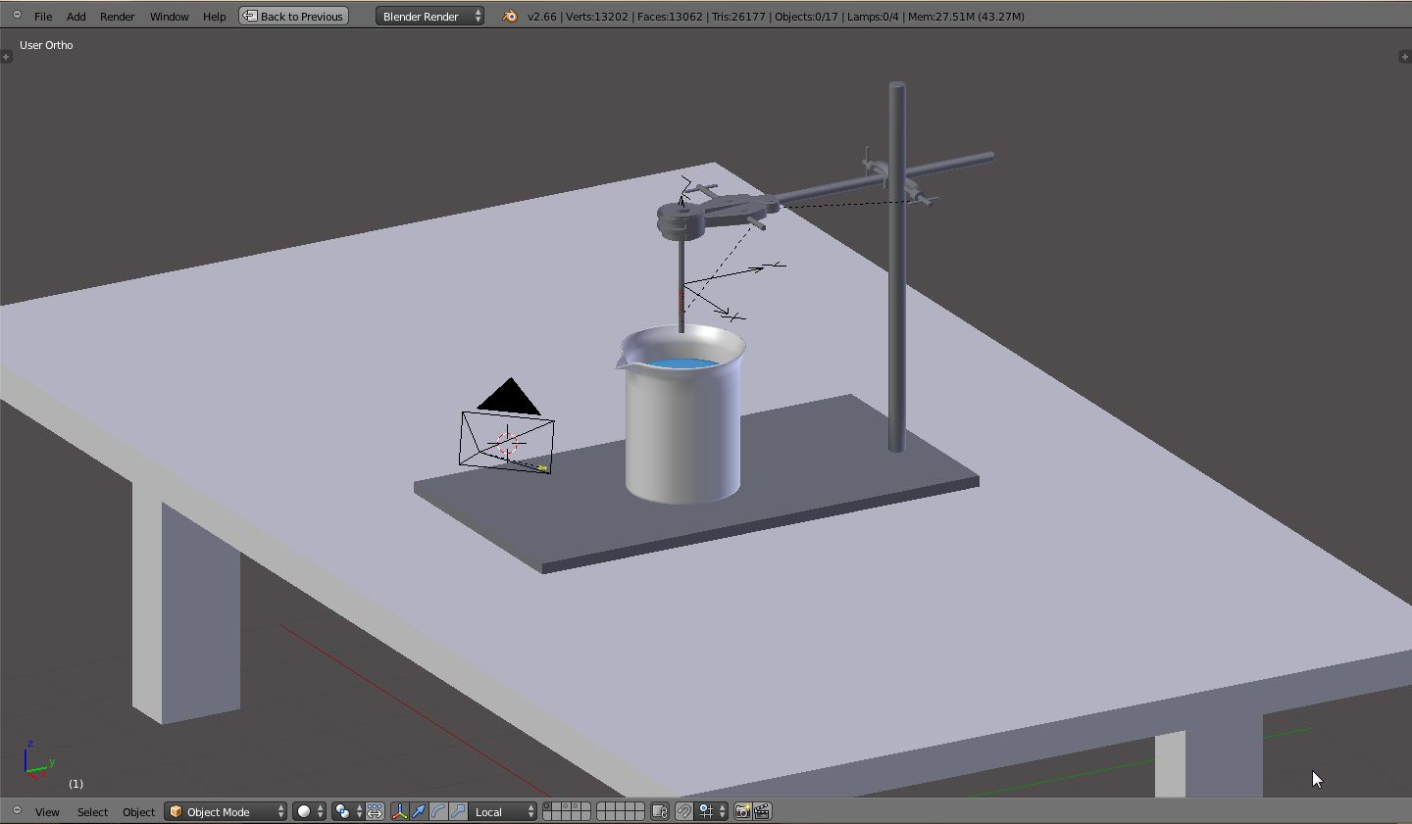
Step 1: Modeling

Slide 3
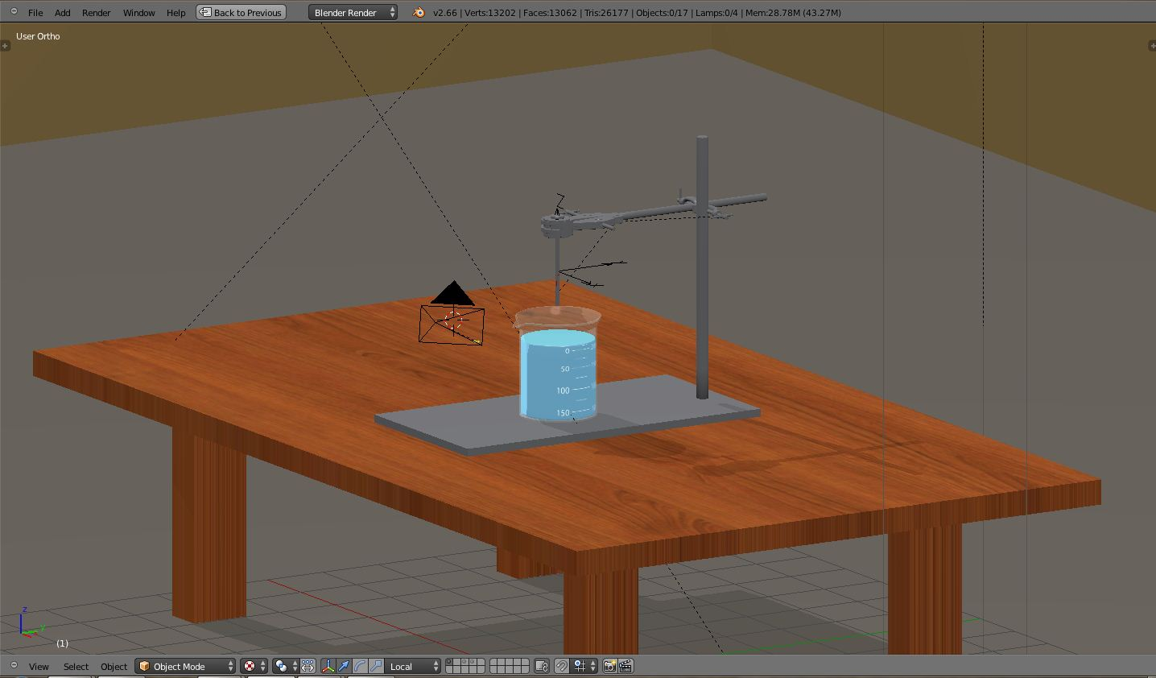
Step 2:Material And Lighting

Slide 4
Step 3: Interactivity
Logic Bricks
Python Scripts
Animation

Slide 5
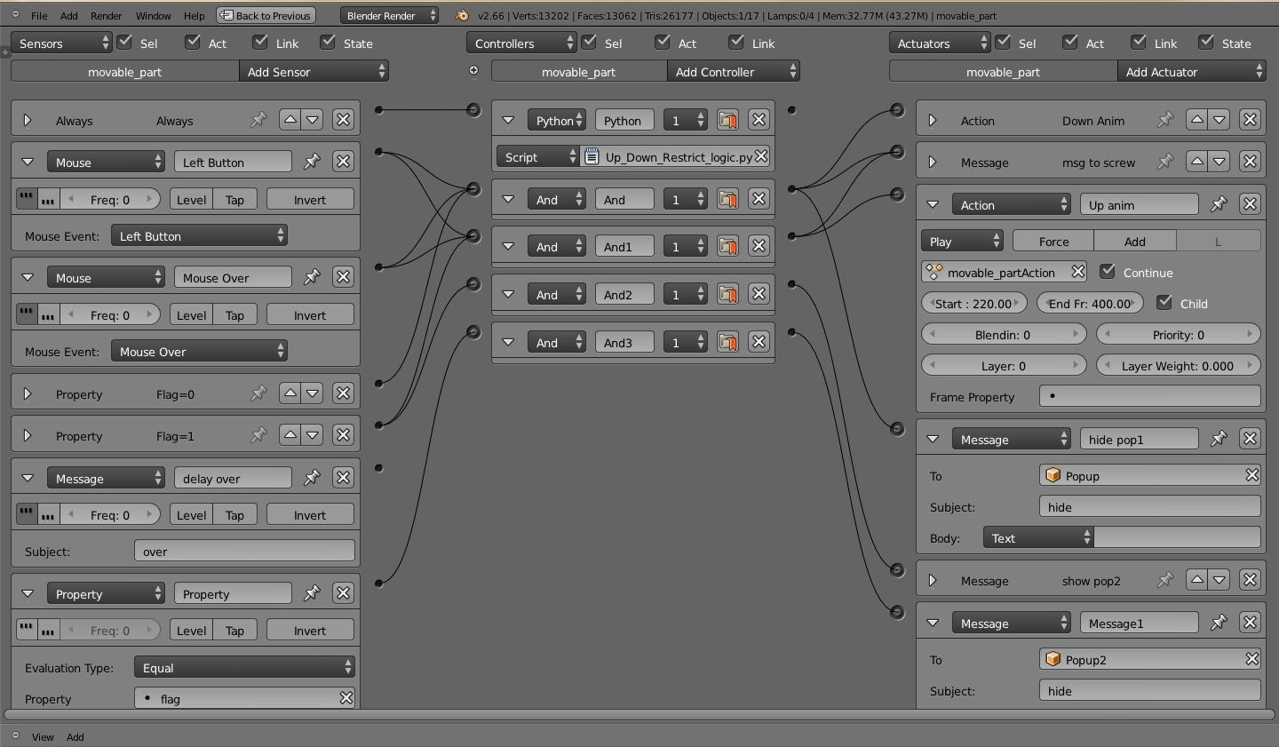
Logic Bricks

Slide 6
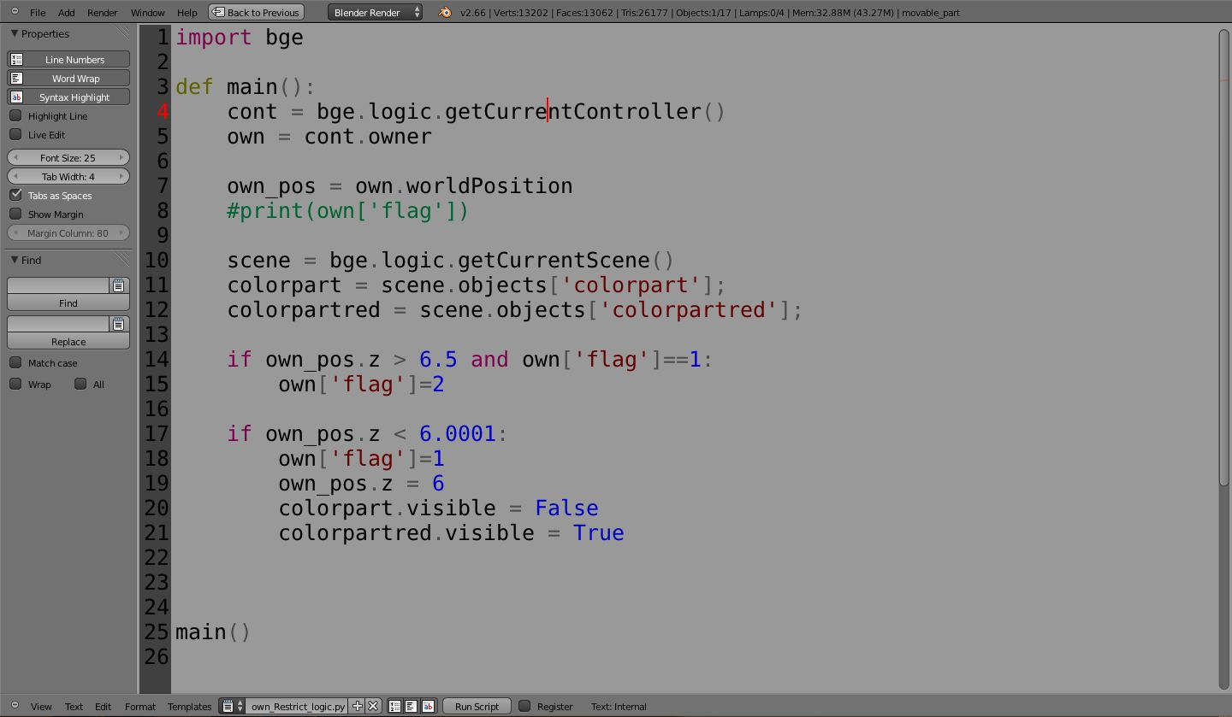
Python Script

Slide 7
Working on Aakash Tablet
Download blenderplayer.apk file from
http://download.blender.org/ftp/incoming/
Install the blenderplayer.apk
on Aakash Tablet

Slide 8
Working on Aakash Tablet
Transfer the .blend file to Aakash Tablet
Open the blender player on Aakash Tablet
Browse the .blend file
Start Blender Player

Slide 9
Credits
Sneha Deorukhkar
Nitin Ayer
Arun Nair
Pooja Bhawar

